Slide 1







Enterprise Blockchain Developers (Intermediate)
In support of
Powered By

Slide 2
Outline
React Node Web3 Integration
Webpack
Webserver
© 2017-2020 SmartMesh Foundation Pte. Ltd. | MeshBox Foundation Pte. Ltd.

Slide 3
Code Demo
1 Add Web3 to React (Code Demo)
2 Integrating React to Nodejs

Slide 4
Lanuch a project on production
1. compile the frontend
or
Dockernize / daemonize the backend and frontend
3. config webserver /var/www/html
4. config DNS

Slide 5
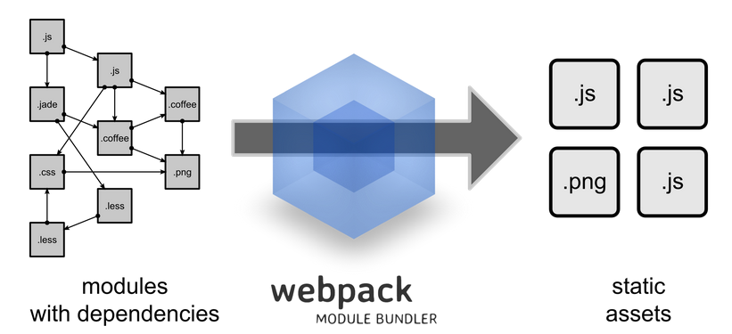
What is Webpacks
The ultimate goal of webpack is to unify all these different sources and module types in a way that's possible to import everything in your JavaScript code, and finally produce a shippable output.

Slide 6
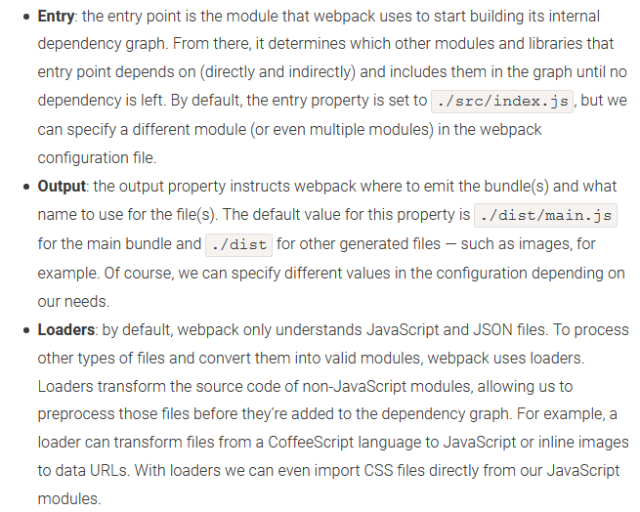
What is Webpacks
The ultimate goal of webpack is to unify all these different sources and module types in a way that's possible to import everything in your JavaScript code, and finally produce a shippable output.

Slide 7
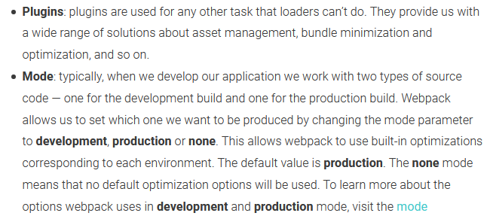
What is Webpacks
The ultimate goal of webpack is to unify all these different sources and module types in a way that's possible to import everything in your JavaScript code, and finally produce a shippable output.

Slide 8
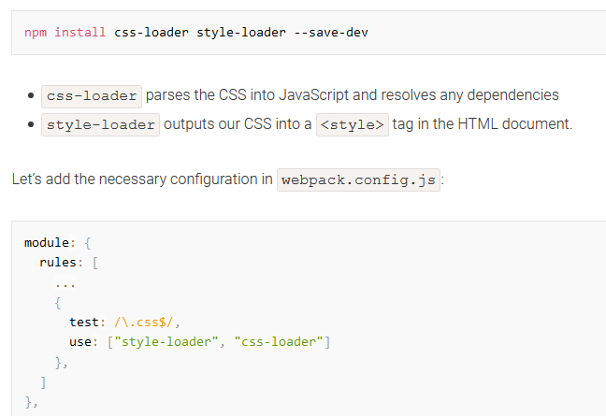
What is Webpacks
Plugin Example

Slide 9
Compile the frontend
Webpack vs Pracel vs react build etc
react-scripts hides all of the webpack configs behind the scenes.
Pracel cannot do code splitting

Slide 10
Code Demo
Dockernize Frontend and backend

Slide 11
Apache
What is Apache and a Web Server?
Apache is a web server software. The web server checks for the web page you have requested and fetches it for your viewing pleasure. However, A web server is not just your host but also your server. Once it has found the web page you requested, it also serves you the web page
© 2017-2020 SmartMesh Foundation Pte. Ltd. | MeshBox Foundation Pte. Ltd.

Slide 12
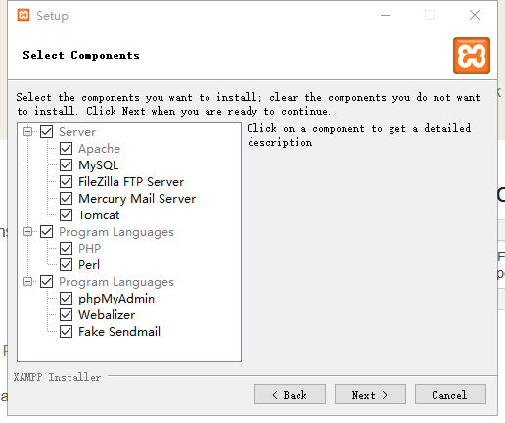
Apache
XAMPP (explain the folder structure)
© 2017-2020 SmartMesh Foundation Pte. Ltd. | MeshBox Foundation Pte. Ltd.

Slide 13
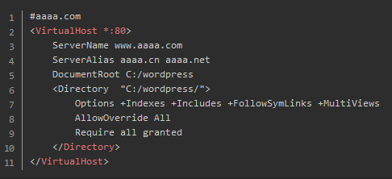
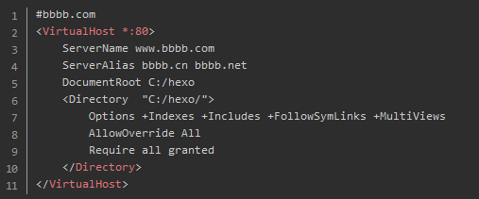
Apache
XAMPP: Host muliple websites
© 2017-2020 SmartMesh Foundation Pte. Ltd. | MeshBox Foundation Pte. Ltd.

Slide 14
Nginx
What is Nginx?
NGINX is open source software for web serving, reverse proxying, caching, load balancing, media streaming, and more.
(explain the folder structure)
© 2017-2020 SmartMesh Foundation Pte. Ltd. | MeshBox Foundation Pte. Ltd.

Slide 15
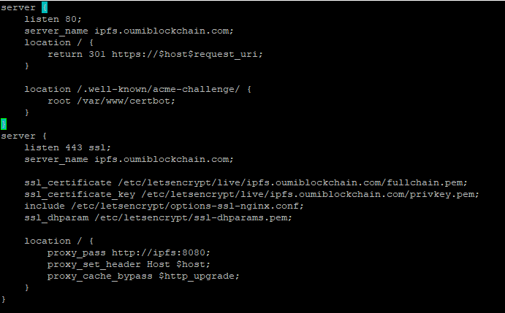
Nginx
What is Nginx?
reverse proxying
© 2017-2020 SmartMesh Foundation Pte. Ltd. | MeshBox Foundation Pte. Ltd.

Slide 16
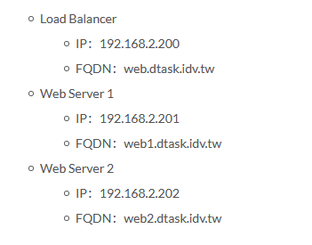
Nginx
What is Nginx?
Load Balancing
© 2017-2020 SmartMesh Foundation Pte. Ltd. | MeshBox Foundation Pte. Ltd.

Slide 17
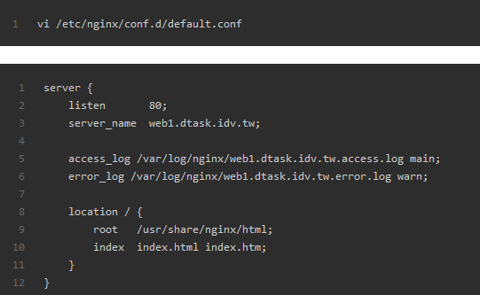
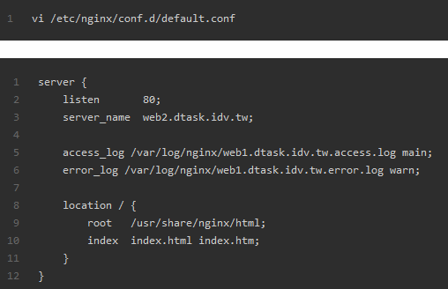
Nginx
Load Balancing
© 2017-2020 SmartMesh Foundation Pte. Ltd. | MeshBox Foundation Pte. Ltd.

Slide 18
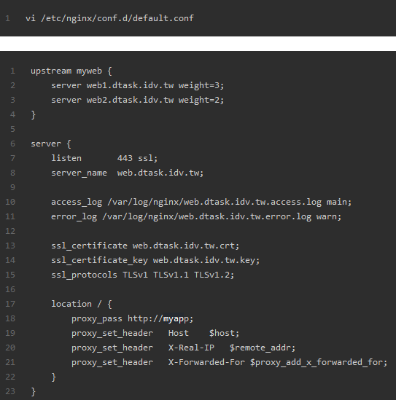
Nginx
Load Balancing
© 2017-2020 SmartMesh Foundation Pte. Ltd. | MeshBox Foundation Pte. Ltd.

